Slide 1
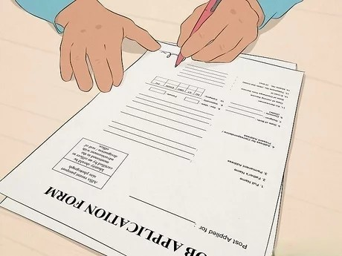
Elements of the Job Applicaction Process

Slide 2
I HAVE DIVIDED MY PRESENTATION INTO THREE PARTS.
Crafting and impressive CV, tips taken from an article written by Katy Cowan.
Six steps to follow to get a better job interview.
How to deal with job application rejection.

Slide 3

Presentation is Key
Include your most important information
No more than two pages of A4
Just be clear and concise.
Presented on clean white paper, use an A4 envelope.
The layout should be clean and it never be folded

Slide 4

UNDERSTAND

Slide 5
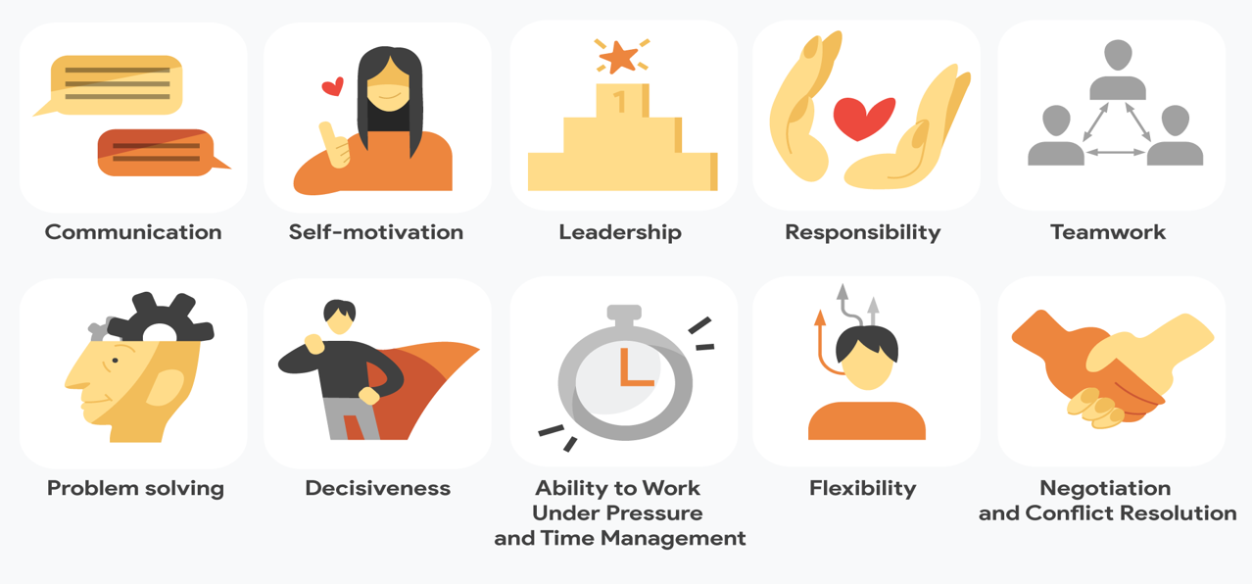
Making the Most of the Skills

Slide 6
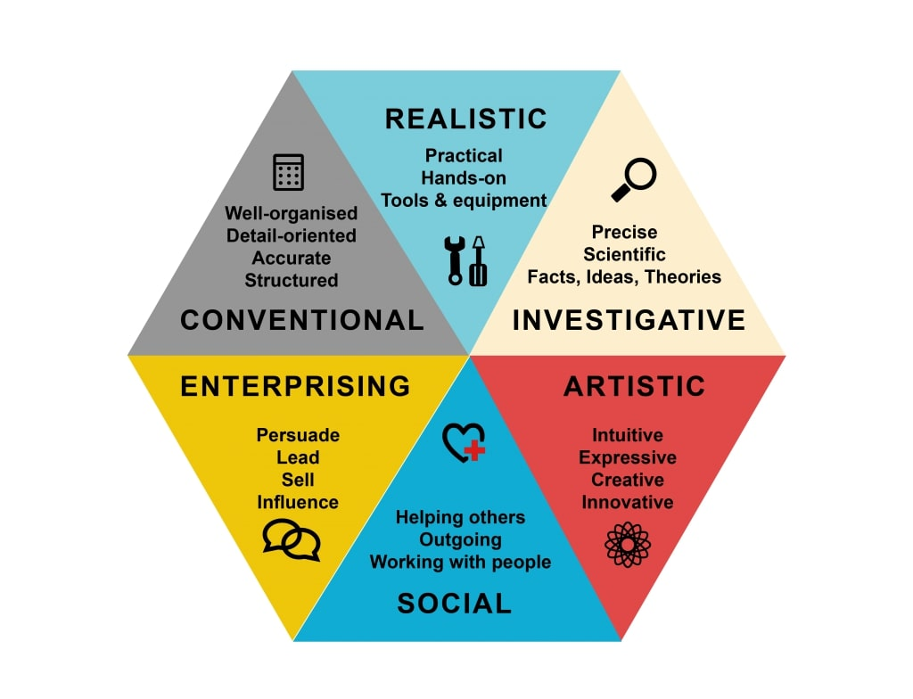
Making the Most of Interests

Slide 7
Keep your CV Updated
Be punctual.
Try to anticipate.
First impression matters.
Nerves control.
Don't lie.
Lastly, say” thank you”.

Slide 8

How to Deal with a Job Rejection

Slide 9


Slide 10
Thank you for listening

